Slide 1
Cost effective use of unmanned ships in short sea shipping
Safe positioning and navigation for automatic surface vessels
Trondheim, June 15. 2017
Ørnulf Jan Rødseth, Senior Scientist, SINTEF Ocean
General Manager, Norwegian Forum for Autonomous Ships
Notes:
20 minutter presentasjon, 1330 til 1350.

Slide 2

Norwegian Forum for Autonomous Ships
Established October 4th 2016
Operated as a joint industry project at SINTEF Ocean.
General Manager is Mr. Ørnulf Jan Rødseth.
A board of governors overseeing operations. General assembly approves budgets and strategies.
42 Institutional Members
  Including Industry, authorities, class, insurance research, universities, ports …
  2 other institutions as personal members
http://nfas.autonomous-ship.org

Slide 3
Why autonomous ships ?

Slide 4
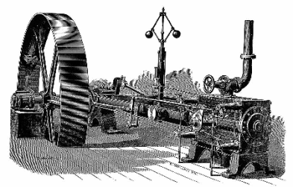
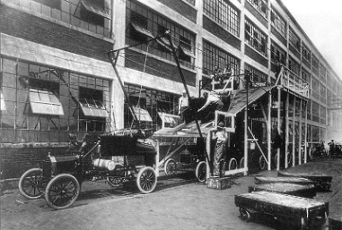
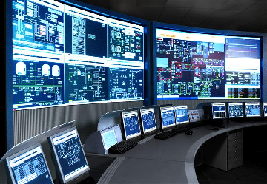

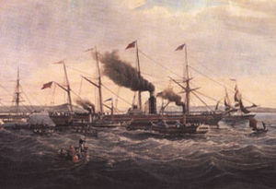
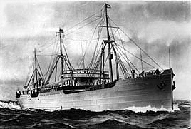
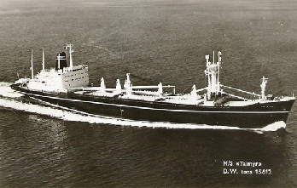
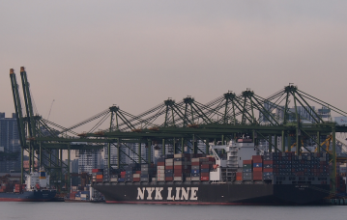
The fourth shipping revolution is on
Ind 4.0
1800
1900
1970
2010
1. Mechanized
Power
2. Mass
Production
3. Computerized
Control
4. Cyber-Physical
Systems +++
Notes:
SS Great Western, the first purpose-built transatlantic steamship, on its maiden voyage in 1838. Seagoing ships from 1813 and onwards.
M/S Selandia, (one of the) first ocean going motor ships. Built by B&W Copenhagen 1911.
M/S Taimyr, first fully digital engine control, launched 1969 (Autochief by Kongsberg Norcontrol). Kinkasan Maru var det første ikke-computeriserte fullautomatisere større skipet. Sjøsatt august 1961.
Port of Singapore, NYK Line ship “NYK Adonis”: Helautomatisk systemer, digitalisering og robtisert lasthåndtering illustrerer noen av elementene I Shipping 4.0

Slide 5
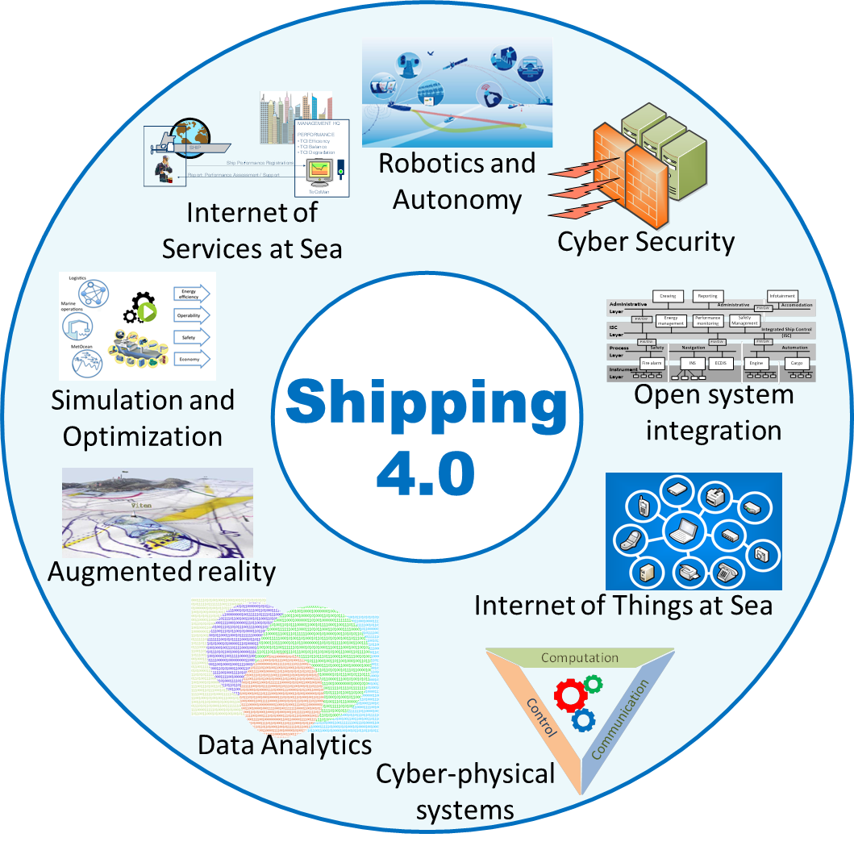
© SINTEF Ocean

Slide 6
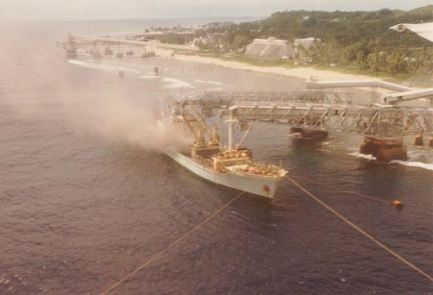
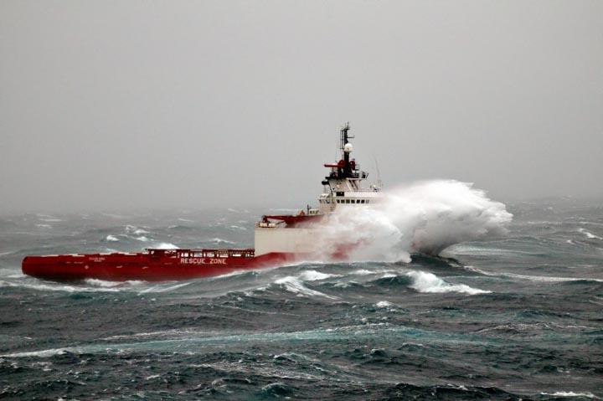
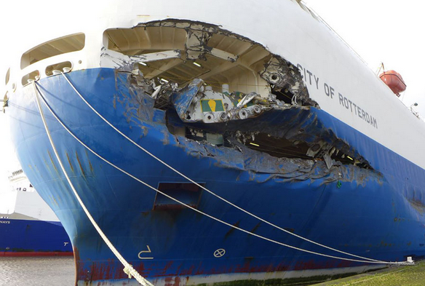
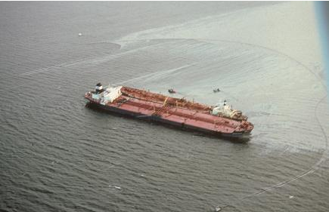
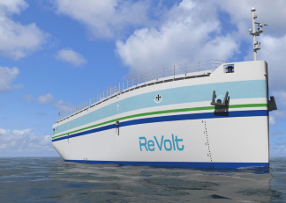
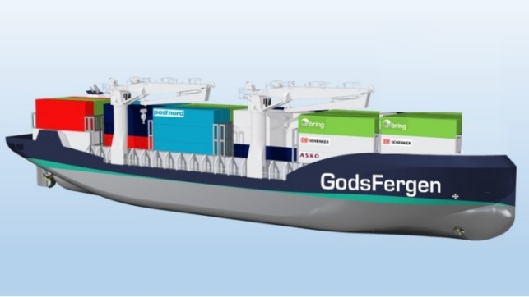
Why autonomous ships?
Wikmedia Commons
Sjøfartsdirektoratet
MAIB, UK
Less dangerous exposure for crew
Remove bad working conditions
Less damage related costs
Exxon Valdez Oil Spill Trustee Council
Fewer large oil spills
Lower emissions
New ship types
NCE Maritime Clean Tech & NCL

Slide 7

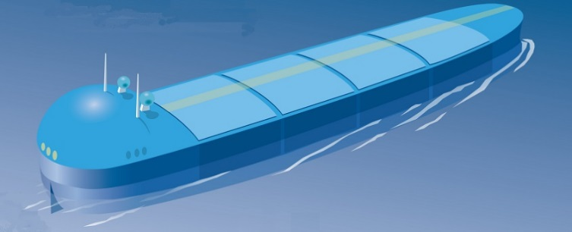
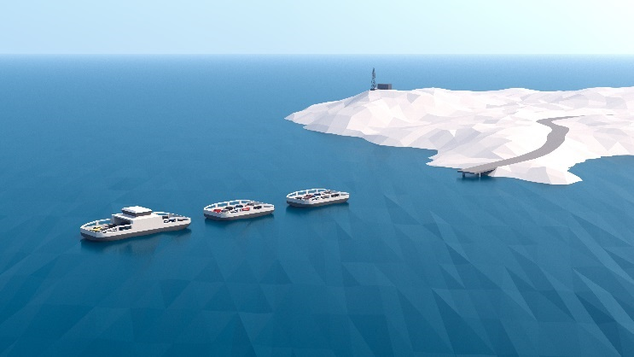
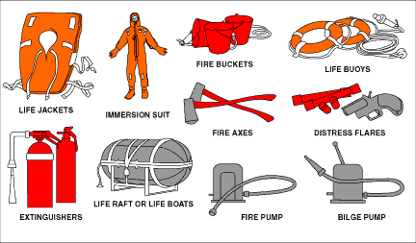
Completely unmanned gives largest benefits!
No accommodation + superstructure
Less power
More cargo
No crew
Reduced crew related costs
Enables completely new ship concepts
No safety equipment
New constructions
This may also challenge the traditional "economy of size" paradigm in shipping!

Slide 8
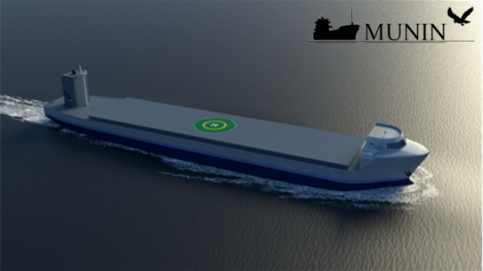
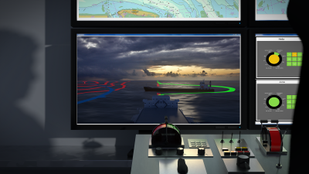
Constrained autonomy: Using a shore control center !

Slide 9



Cost-benefit
No hotel or safety equipment, more cargo
No crew
Improved efficiency, lower fuel
Less off-hire
New business model
Dual propulsion, no HFO, redundancy
More advanced maintenance
Costlier instruments
New infrastructure
Shore Control Centre
Existing business model

Slide 10
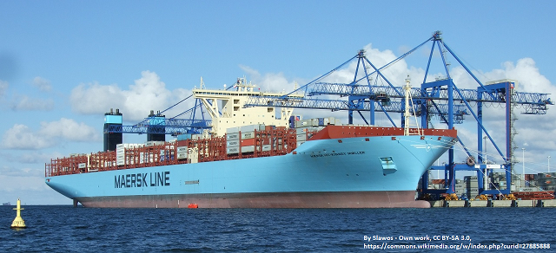
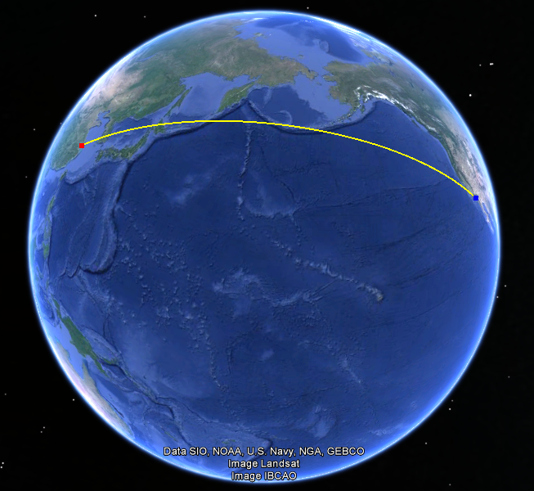
Deep sea is feasible, but not first mover !
10 000 TEU container vessel
Shanghai – Los Angles
  Two states involved
  6000 nm, open sea
  No channels
  Short port approach
  Remote control to port
Dual propulsion systems
Two stroke diesels
Biofuel, methanol …

Slide 11
Developments towards unmanned ships
Various special ships, like small passenger ferries or car-ferries, military applications
Today's technology
Improved decision support
Periodically unmanned bridge
Fully unmanned inter-continental ships
Small local transport vessels
Larger coastal/supply vessels

Slide 12
So, what is going on in Norway?

Slide 13
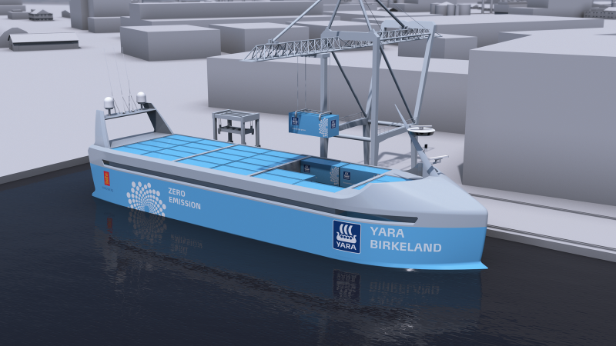
Yara Birkeland
Yara fertilizer
Kongsberg partner
Replaces 40 000 truck trips a year

Slide 14
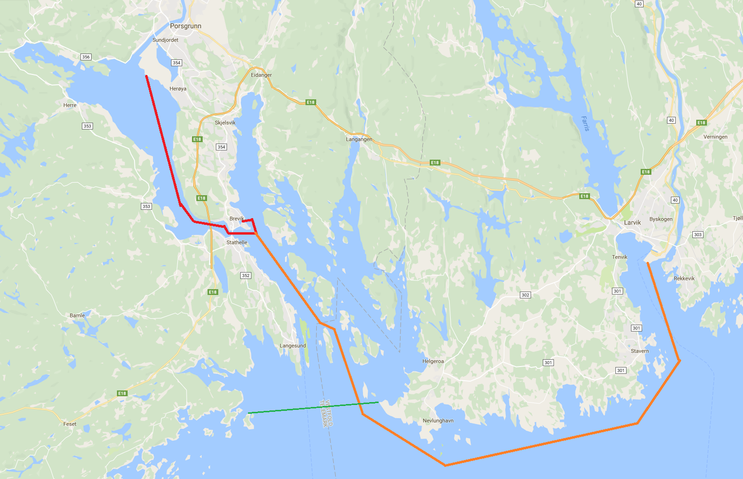
Yara Birkeland Operation
Features
  100-150 TEU, 70 m x 15 m
  Batteries – Fully electrical
Staged implementation
  Manned after 1 year
  Remote after 2 year
  Autonomous after 3 year
Operational area
  Herøya-Brevik – 7 nm
  Herøya-Larvik – 30 nm
  Within Brevik VTS area

Slide 15
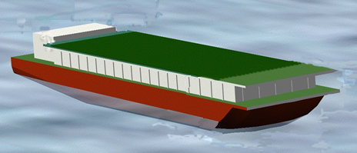
Autonomous Ship Transport at Trondheimsfjorden (ASTAT)
Short voyages
12-50 TEU
Inland, fjords/sheltered
Low cost: Wait in port
Legs 4-12 hours
Port cranes
Automated berthing
Batteries

Slide 16
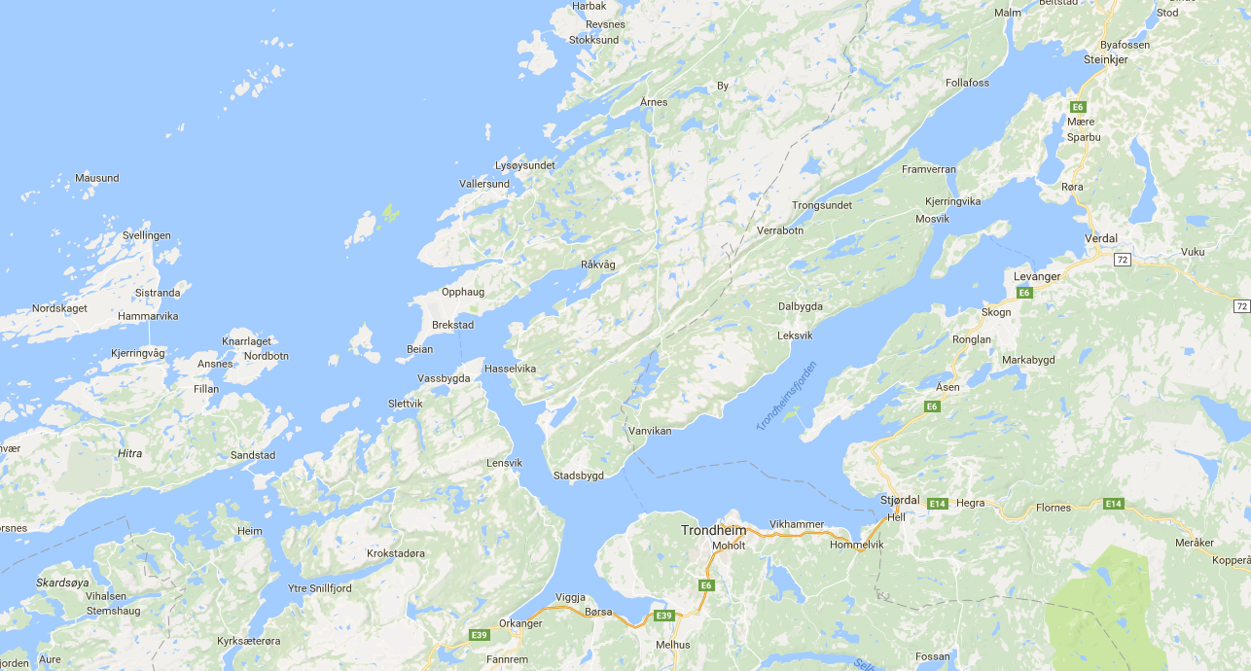
Lumber: Orkanger-Skogn/Follafoss
Gravel: Verrabotn-Trondheim
Aquaculture: ACE
Feeder: Jøsnøya-Trondheim/Orkanger++

Slide 17

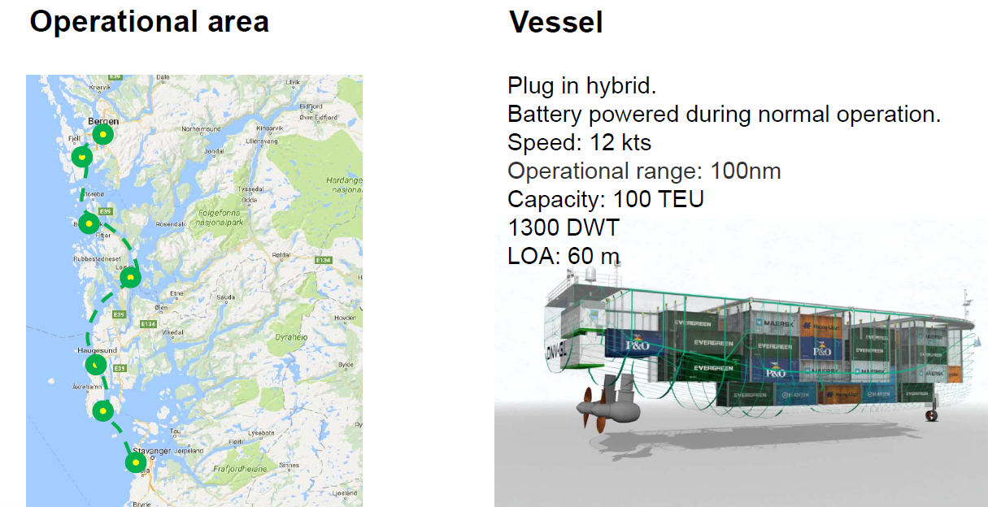
GREEN COASTAL SHIPPING PROGRAMME
Pilot 8: AUTONOMOUS COASTAL CONTAINER FEEDER

Slide 18
Conclusions
Autonomous ships will be a disruptive factor in transport! They can change balance between short sea ships and truck transport and can also disruptively change international shipping.
Applications must be selected to fit the technological and operational constraints, short sea is a promising first application!
Several projects are already under way, but all in design phase!

