Slide 1
The role of digital communication technology in e-Navigation – the need for new infrastructure
Ørnulf Jan Rødseth MSc
Research Director, MARINTEK
OrnulfJan.Rodseth@marintek.sintef.no

Slide 2
The role of digital communication technology in e-Navigation – the need for new infrastructure
Existing communication systems
Basic overview of current requirements
Emerging requirements from e-Navigation and e-Maritime
Summary and conclusions

Slide 3
Four main communication "channel types"
Dedicated (narrow band) shore/ship and ship/ship data links (AIS, DSC, VHF, HF, MF …)
Dedicated (narrow band) satellite (GNSS, EPIRB, LRIT, SSAS, SafetyNET , AISSat …)
Commercial shore to ship (GSM, WiMax, WiFi …)
Commercial satellite services (Inmarsat, Iridium, VSAT …)
  M2M message based (also Orbcomm)
  Internet type data link

Slide 4
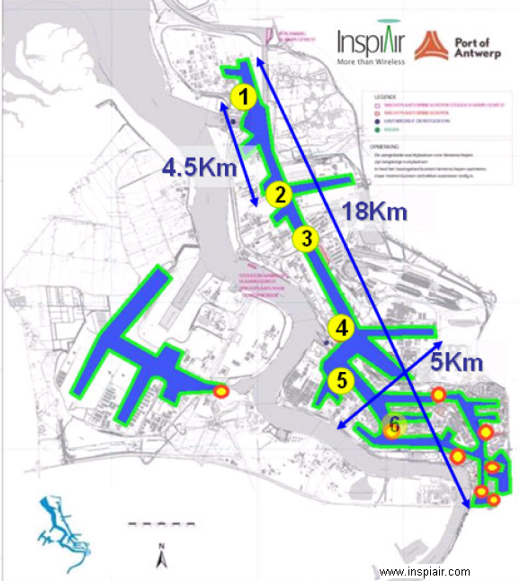
Existing shore based systems
Cell phone systems
  Work well in ports
  Less good along coast (# subscribers)
  Problem with roaming-agreements
WiFi
  Deployed in some ports
  Simple access and low cost equipment
  Limited range
  Operates in non licensed band
CDMA 450
  Deployed in Norway and some other countries
  Long range, good bandwidth
  Licensed frequencies
  Large cells
Notes:
Rotterdam port offer WiFi to visiting ship: Range of some kilometers from
base stations.
Not really a viable alternative for general coastal services as service operates in
Non-licensed band and competes with all other services and because of limited
Range and power levels.

Slide 5
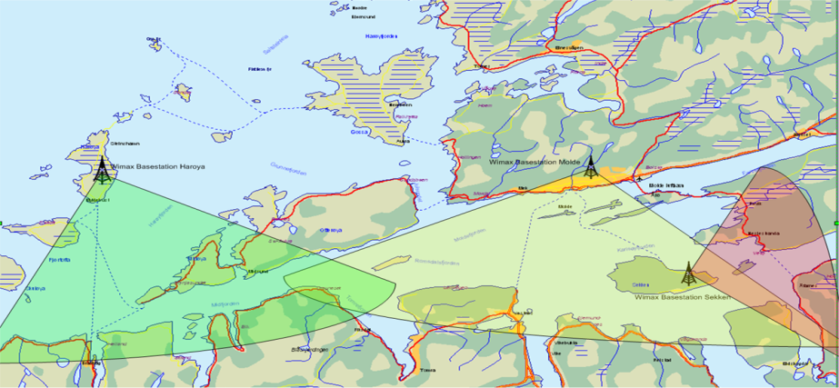
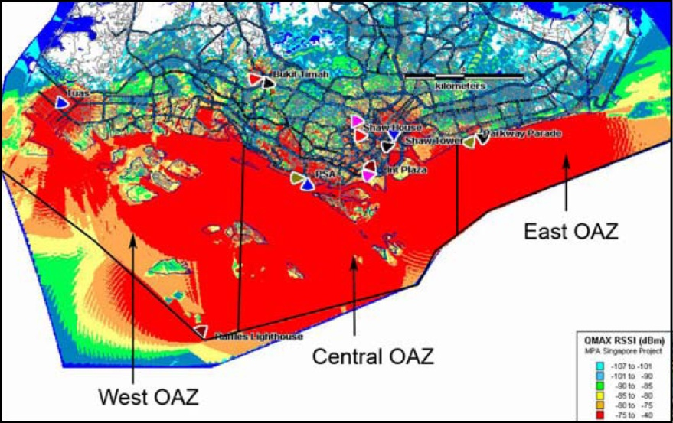
WiMAX – Worldwide Interoperability for Microwave Access
”Last mile” system at west coast
of Norway
orkidenett.com
10 – 20 km range
256k to 5 Mbps
Standard end user equipment (Intel)
May use specialized base stations
2.3 to 5 GHz
Commercial service in Singapore: WISEPORT
www.qmax.com.sg
Notes:
WiMax is very interesing technology, but no suitable frequencies are currently
available for shipping. Need fairly wide frequency channels for good performance
WiMAX IEEE 802.16a protocol allows for a max of 100 Mbit/s per 20 MHz channel.
The picture shows coverage in Singapore (Commercial service to visiting ships)
And a last mile solution used on the west coast of Norway that also offers
Services to highway ferries in the area.

Slide 6
AIS or DSC ?
AIS has an effective bandwidth of about 6 kbps / 25 kHz channel
DSC supports 1.2 kbps on VHF
AIS and DSC have dedicated purposes and should not be used for other purposes without proper consideration to potential problems.
However, both could be used given that additional frequencies are assigned.

Slide 7
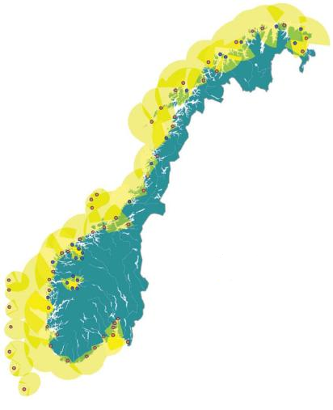
Digital VHF
Existing VHF Channels
  Up to 70 km range
  9 Channels
  22 kbps/channel (4 * AIS)
  High reliability
  Message type
Very interesting for e-Navigation
  Same properties as VHF, AIS and other GMDSS components
  Can use same land infrastructure
  Low cost system and equipment
Telenor Maritim Radio
Notes:
This is deployed in Norway and is being cosnidered in otehr areas.
Much higher capacity than AIS: 4 channels should be enough for higher service level
requirements, fewer may be used if less demanding applications or cooperation with
Satellites are used.

Slide 8
Different modulation schemes proposed
ITU Recommendation M.1842
  22 kbps / 25 kHz Channel (0.84 bit/Hz)
  Use one single VHF channel per digital channel
  Operate on low Signal / Noise : Long range and high reliability
Document 5B/19, ITU Working Party 5B
  153 kbps / 50 kHz Channel (3.1 bit/Hz)
  Require two adjacent VHF channels
  Require much better S/N: Probably shorter range and lower reliability
New developments look at e-Navigation applications (VDE)
  Six channels proposed (25, 85, 26, and 86, 24 and 82 for operations)
  Merged channels for higher bandwidth
  Split channels for more diversity
Notes:
Formula is: The capacity of a link (C) is a function of Bandwidth (B) and Signal / Noise
Ratio (S/N). Higher capacity requires better S/N and will be more sensitive to
Noise to interrupt communication.
Thus, although a higher utilization of the bandwidth can be used, this will have effects on range
And reliability.
However, systems with mixed modulation schemes could be a good solution
(high bandwidth for near shore and lower bandwith farther out).

Slide 9
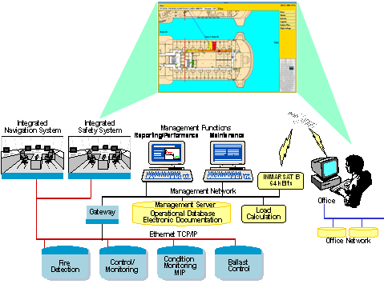
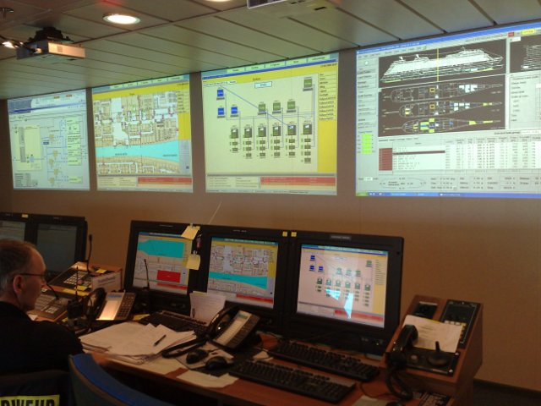
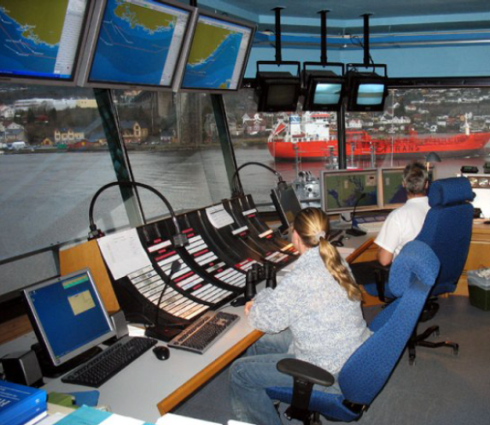
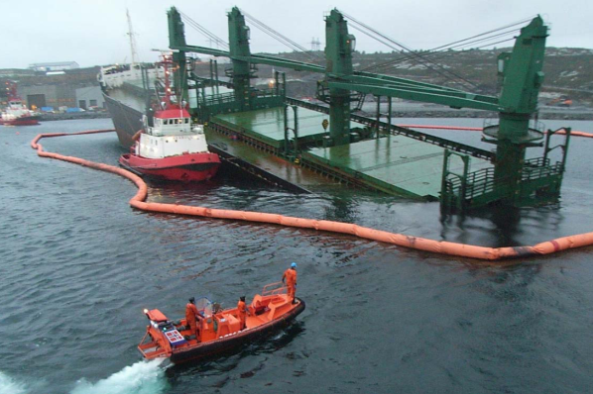
VDE can also be used in ship – ship coordination
Port approach
Emergencies
etc …
© BW Gas
© Kystverket

Slide 10
New MF-NAVDAT service proposal
ITU-R M.2010
495 to 505 kHz (MF)
Expected effective bit rate 12-18 kbps
Additional to NAVTEX
  Same time slot scheme?
  NAVTEX has 100 bps at 518 kHz

Slide 11

Satellite systems:
GEO: Geostationary Earth Orbit
Benefits (Inmarsat and other VSAT)
  Close to global coverage
  Satellite is stationary relative to earth
Drawbacks
  Weak signal
  Latency
  Shadows
    Polar regions
    Fjords
  Ship movement
  Rain fading (Ku)
© NTNU/Odd Gutteberg
www.marcom.no
Notes:
Shows the problem of GEO systems.

Slide 12

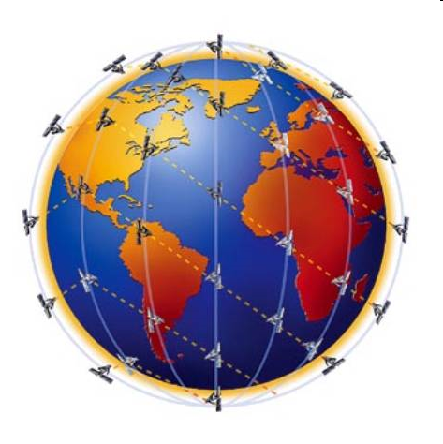
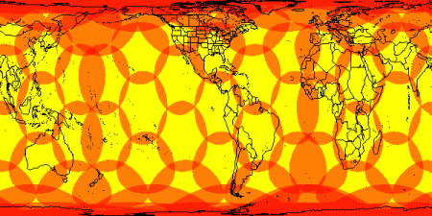
Satellite systems
LEO: Low Earth Orbit
www.iridium.com
Iridium
  Orbit hight 780 km, 66 satellites
Also some other less relevant systems
  Globalstar (1400 km / 48 satellites)
  Orbcomm (775 km / 29 satellites)
Benefits
  Signal strength
  Low latency
  Global coverage
Drawbacks
  Complexity
  Commercial viability ?
  Doppler shift effects
  Relatively low bandwidth
www.marcom.no
Notes:
Iridium is a low orbit system. OpenPort ™ is the new digital communication
Serice, up to 128 kbps (Internet connectivity).
Commercial viability is uncertain as the sattelittes need to be replaced
over the coming years.
Very fast movement of satellittes relative to ground causes signal processing
and handover problems, particularly near equator where satellitte density is
Low. Complex system for passing signal between satelittes until ground station
Is reached: Cause latency of 1 to 2 seconds.

Slide 13
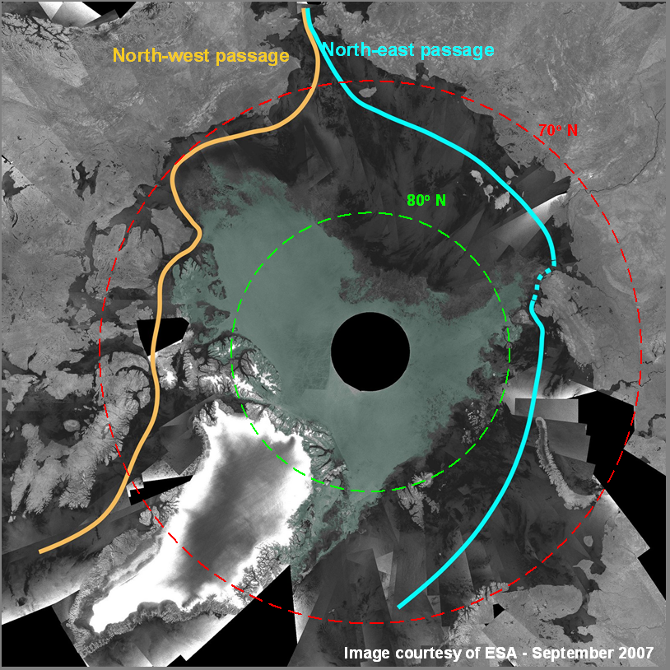
Communication technology in Arctic
High Elliptic Orbit (Molnyia)
Low Earth Orbit (Iridium)
Various other concepts
© NTNU/Odd Gutteberg
Notes:
Limited satellite coverage in polar areas and Ionospheric disturbances (also outside Brazil) create problems for L-band (global positioning systems) as well as Inmarsat safety communication.

Slide 14
The role of digital communication technology in e-Navigation – the need for new infrastructure
Existing communication systems
Basic overview of current requirements
Emerging requirements from e-Navigation and e-Maritime
Summary and conclusions

Slide 15
Main classes of "mandatory" ship communication
Low bandwidth data exchanges: GNSS, EPIRB, DGPS, EGNOS, DSC, SSAS, LRIT ...
Ship movement, AtoN via AIS, VTS advice …
Other safety or security related information via AIS, NAVTEX, SafetyNet , ice warnings …
Ship reporting, port reports, waste reports …
Updates to critical documents and data on board, e.g., notice to mariners, ECS, certificates ...
Basic position and safety services
Navigational advice
Maritime information
Mandatory ship reporting
Documentation updates

Slide 16
Main classes of "commercial" ship communication
Operational reporting, e.g., voyage reports, port reports ...
Technical and operational support, technical systems diagnostics, technical monitoring, KPI transfers, remote interventions ...
Crew infotainment, CBT, e-mails, Internet access ...
Data transfers related to payload, e.g., cargo (container monitoring), passengers (Internet access) or special missions (hydrographic, seismic) …
Operational reporting
Operational support
Crew infotainment
Payload data exchange

Slide 17
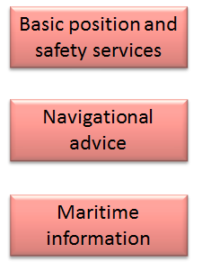


Today's mandatory communication patterns
Narrow band mandatory information
  Requirements are more or less driving technology, i.e., they match
  Some spare capacity in AIS, but basic capacity is only about 6 kbps/channel with binary messages
Mandatory ship reporting
  Can be done over 9.6 kbps Inmarsat C system or voice
Document update
  Over satellite or in port – need fairly high bandwidth

Slide 18



Today's commercial communication patterns
Other reporting requirements
  Important for efficient operation. More and more ships are on line, but one may manage without: Coastal (GSM) or satellite – need fairly high bandwidth
Operational support
  Increasing, but not common – used if satellite capacity allows
Crew infotainment
  An important force in deployment in VSAT – use all available resources

Slide 19
The role of digital communication technology in e-Navigation – the need for new infrastructure
Existing communication systems
Basic overview of current requirements
Emerging requirements from e-Navigation and e-Maritime
Summary and conclusions

Slide 20

e-Navigation and e-Maritime
e-Navigation
  Focus on nautical aspects (IMO domain)
  International
e-Navigation

Slide 21
E-Navigation prioritized applications
Solution 1: Improved, harmonized and user-friendly bridge design
Solution 2: Means for standardized and automated reporting
Solution 3: Improved reliability, resilience and integrity of bridge equipment and navigation information
Solution 4: Integration and presentation of available information in graphical displays received via communication equipment.
Solution 9: Improved Communication of VTS Service Portfolio.

Slide 22
E-Navigation prioritized applications
Solution 1: Improved, harmonized and user-friendly bridge design
Solution 2: Means for standardized and automated reporting
Solution 3: Improved reliability, resilience and integrity of bridge equipment and navigation information
Solution 4: Integration and presentation of available information in graphical displays received via communication equipment.
Solution 9: Improved Communication of VTS Service Portfolio.

Slide 23
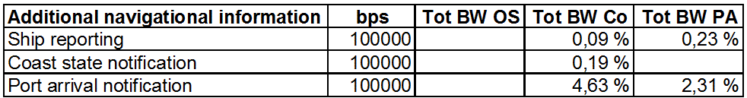
Estimated demands for automated reporting
Normalized bandwidth of 100 000 kbps
10/100/250 ships in open sea/coastal/port approach
Mean utilization of channel
All messages are unicast
Rødseth Ø.J., Kvamstad B. Digital Communication Bandwidth requirements for Future e-Navigation Services, European Journal of Navigation, Vol. 7, No. 1, April 2009.
www.mits-forum.org

Slide 24
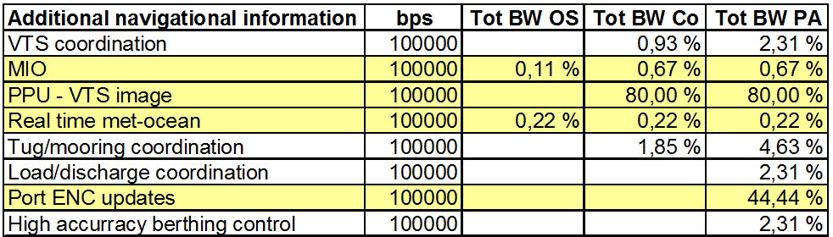
Estimated demands for other possible e-Navigation communication
Normalized bandwidth of 100 000 kbps
10/100/250 ships in open sea/coastal/port approach
Mean utilization of channel
All messages except yellow are unicast, these are broadcast
Rødseth Ø.J., Kvamstad B. Digital Communication Bandwidth requirements for Future e-Navigation Services, European Journal of Navigation, Vol. 7, No. 1, April 2009.
www.mits-forum.org

Slide 25
Satellite or coastal infrastructure ?
A2B: Authority to Business
  Requirements will have to satisfy minimum requirements
  Services should be "free"
Satellite may be shaded in ports or fjords and in the high north.
VDE (VHF Data Link) may be made as low cost equipment, e.g., integrated with AIS or VHF radio.
Port state authorities may want to have control over infrastructure and frequencies may have to be standardized.
VDE + NAVDAT is most likely?

Slide 26

e-Navigation and e-Maritime
e-Navigation
  Focus on nautical aspects (IMO domain)
  International
e-Maritime
e-Navigation
e-Maritime
  Wider scope: Maritime transport
  European

Slide 27
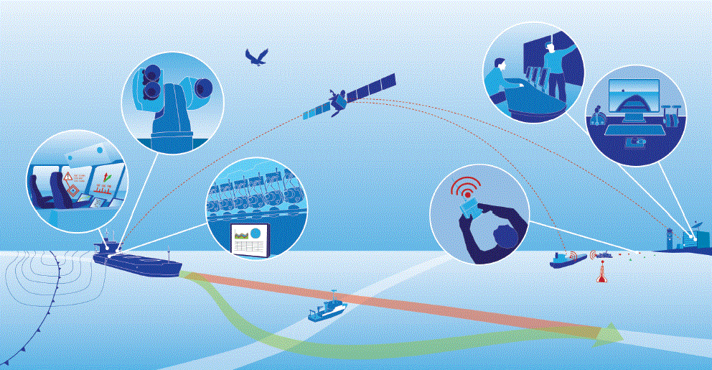
Unmanned or shore supported ships ?
Estimated from 75 kbps to 4 Mbps dependent on mode
May operate without link for some time, will "fail to safe"
Investigated in EU-project MUNIN: www.unmanned-ship.org

Slide 28
Satellite or coastal infrastructure ?
B2B: Business to Business
  Requirements driven by commercial operations
  Services need not be "free"
Not mission critical and may tolerate drop outs in some areas
Will be part of systems to also cover crew infotainment and other high capacity demands.
No need for port state authorities to have control over infrastructure or to allocate specific frequencies.
Satellite is most likely!

Slide 29
The role of digital communication technology in e-Navigation – the need for new infrastructure
Existing communication systems
Basic overview of current requirements
Emerging requirements from e-Navigation and e-Maritime
Summary and conclusions

Slide 30
Summary and conclusions
e-Navigation will require some dedicated and additional bandwidth. This will mostly be near to shore or in port approaches.
AIS will generally not have capacity, has its own dedicated purpose and is not very bandwidth efficient.
VDE seems to be most promising alternative, given that IMO and ITU agrees. Reuse of some VHF voice frequencies will give sufficient additional bandwidth.
MF/NAVDAT can be a supplement at longer distances.
E-Maritime will most likely rely on satellite or high speed terrestrial systems.

