Slide 1
e-navigation ─ enhanced safety of navigation and efficiency of shipping
The status of the IMO e-navigation work and the Strategy Implementation Plan. Where we are and where we are going.
John Erik Hagen Coordinator of IMO Correspondence Group on e-navigation

Slide 2
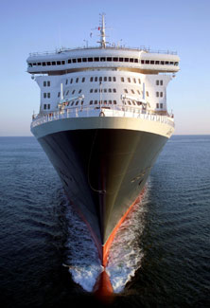
The e-navigation concept
A framework for the effective sharing of essential maritime information.
Intends to promote safety, security and efficiency in global shipping, and, consequently, the protection of marine and coastal environments.
Notes:
e-navigation could be seen as a framework for the effective sharing of essential maritime information. It is defined as the harmonized collection, integration, exchange, presentation and analysis of maritime information onboard and ashore by electronic means. The goal is to enhance berth to berth navigation and related services, for safety and security at sea and protection of the marine environment.
Norway and the Norwegian Coastal Administration have been entrusted by the International Maritime Organization (IMO) to coordinate the work of developing a proposal for a strategic implementation plan for the global e-navigation concept. The work that began in the summer of 2009 will be completed in 2014.

Slide 3
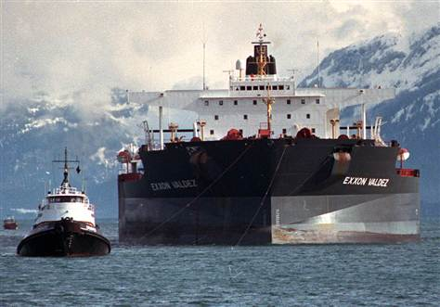
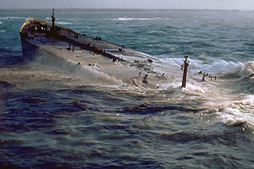
e-navigation needs…
Harmonized and user friendly tools optimized for good decision making
Reliable and robust communication
Proper coordination of technological development
Notes:
We recognize that the key word is harmonization and that there is a clear and compelling need to equip shipboard users and those ashore responsible for the safety of shipping with modern, proven tools that are optimized for good decision making in order to make maritime navigation and communication more reliable and user friendly.
If current technological advances continue without proper coordination there is a risk that the future development of marine navigation systems will be hampered through a lack of standardization on board and ashore, incompatibility between vessels and an increased and unnecessary level of complexity.
The IMO project has received broad international support, and today around 45 countries and 20 international organizations participate in the Correspondence Group.

Slide 4
Roadmap
2009
2010
2011
2012
2013
Survey and prioritizing of User Needs
2014
Survey and prioritizing of User Needs, services and tasks
Initial GAP analysis
Final GAP analysis
Final decision of Strategy implementation plan
Description of functions and services
Selection overarching system architecture
Risk and Cost/benefit analyses
Proposal for a final Strategy Implementation Plan
Notes:
This is the e-navigation road map approved by the IMO Maritime Safety Committee.

Slide 5
I know what I need
Notes:
As you see, the work in the Correspondence Group started with the prioritization of user needs.

Slide 6
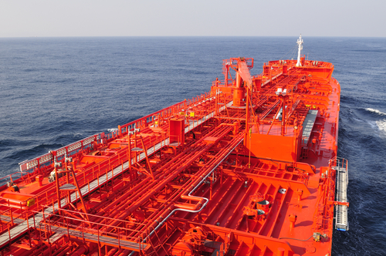
User surveys
User surveys carried out by several Member States and international organizations
Identified areas for improvements
Mariners and land-based personnel participated
24 main categories of user needs were identified
Notes:
Several surveys were carried out by Member States and international organizations to identify areas for improvements. Mariners and land-based personnel participated in the surveys.
And 24 main categories of user needs were identified, of which 14 were onboard, 6 were shorebased and 4 were Search and Rescue related. Additionally, a list of communication needs have been agreed upon.
NAV 56 finalized the list of gaps.

Slide 7
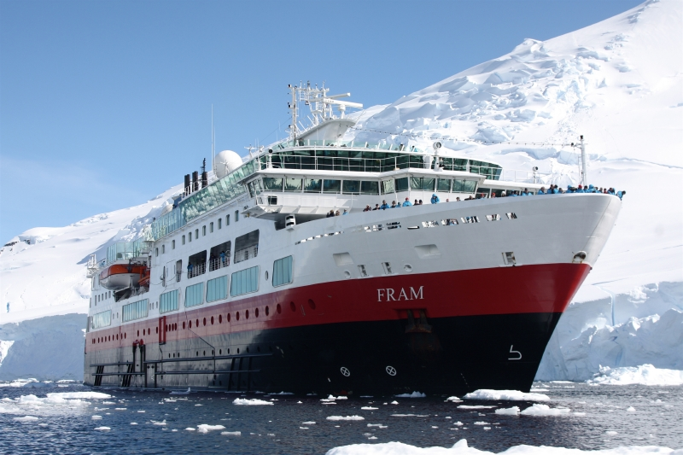
Ship-shore interaction
The use of IHO S-100 standard
An overarching e-navigation architecture in 2012
A Common Maritime Data Structure
An IMO/IHO Harmonization Group on Data Modelling
Notes:
The user needs also identified ship-shore interaction as an important element. The overarching architecture is an example on this. MSC 90 approved the current overarching e-navigation architecture in the spring of 2012.
Coincidently, MSC 90 also approved the use of the IHO S-100 standard as the baseline for creating a framework for data access and services under the scope of SOLAS. They further approved a proposed way forward to develop a Common Maritime Data Structure. In addition, they authorized, in consultation with other organizations, the establishment of an IMO/IHO Harmonization Group on Data Modelling, including its draft terms of reference.
According to the terms of reference, the harmonization group should, using IHO S-100 standard as baseline, harmonize and standardize formats for the collection, exchange and distribution of data, processes and procedures for the collection, and development of open standard interfaces.

Slide 8
The GAP
Status Future
We know where User Needs tell
we are us where we
want to go
Notes:
The next delivery was the Gap analysis.

Slide 9
How to bridge the gap (the Nordic way)
Notes:
And how to fill the gaps…

Slide 10
GAP analysis and references to be taken into consideration, provided by MSC or NAV
1. User Needs
2. Aspects (MSC 86/23/4)
2. Key elements (NAV 54/25/Annex 12)
3. Core objectives (NAV 54/25/Annex 12)
4. Relevant functions (NAV56/WP.5/Rev.1/Annex 1)
5. Operation area (as identified for Maritime Service Portfolios – MSP)
Notes:
There are several references provided by MSC and NAV that have to be taken into consideration during the gap analysis.

Slide 11
Gap analysis delivered
87 gaps identified based on user needs
Four areas for improvement:
Operational, technical, regulatory and training
Main categories identified:
Information and data coordination
Effective and robust communication and data transfer
Navigation systems and onboard equipment
Ship reporting
Training and usability
Traffic monitoring
Could be used as reference in development of new products
Notes:
The Gap analysis was finalized in July last year during NAV 58. The Gap analysis is connected to IMO’s e-navigation strategy plan and IMO’s main strategies. The analysis focused on four areas for improvement: operational, technical, regulatory and training, considered in relation to ship- and shore-based activities and search and rescue services.
In total 87 gaps were identified and allocated in these main categories: information and data coordination, effective and robust communication and data transfer, navigation systems and onboard equipment, ship reporting, training and usability, and traffic monitoring.
Signals received from maritime industry indicate that the Gap analysis could be an important reference in the development of new products and product specifications.

Slide 12
Workshops
Monaco: Focused on harmonization and standardization of e-navigation information based on a common global standard.
Singapore: Trials conducted for exchanging information electronically between Vessel Traffic Service centre and ship based on the IHO S-100 standard.
Haugesund (Norway): Discussed the need for communication in Polar Regions based on electronic exchange of ship-shore information. Trials conducted to survey communication coverage in polar regions.
Notes:
Workshops are important arenas to discuss and test out e-navigation issues. So far three workshops have been carried out, and there will be more to come.
As a follow up of the Singapore workshop, which also identified synergies between the development of e-navigation and the IMO Maritime Electronic Higway-project, it was decided to do a pre-study of a possible establishment of a sea traffic management project in the Malacca and Singapore Straits, utilising existing traffic management tools combined with e-navigation opportunities including innovative solutions.
The objective of the project is to validate the concept of a ship traffic management system (STMS) for increased safety, efficiency and security in the Straits. Efficiency is here mainly related to reduction of bunkers use and corresponding lower Greenhouse Gas emissions, but also to better utilization of ship, coastal state and port resources such as anchorages, berths and pilots.
The next workshop will be held in Australia in March this year. This workshop will focus on usability.

Slide 13
Human Element Analyzing Proces HEAP
.
Notes:
NAV 56 advised the use of The Human Element Analyzing Process (HEAP) as a checklist in the gap analysis.
It is essentially a checklist for issues to consider, in particular relating to the human element, organizational and training issues. HEAP in general is integrated in the gap analysis.
The human element in reviewing and understanding the data is critical. While some aspects could be automated, the watchkeepers (on board and ashore) will be the ones who will need to interpret the information.
The human element within e-navigation will be key to its success, and solutions need to take into account the most effective approach for the user – both on board and ashore. Many have said that the solutions should focus on the outcome, the ‘what is required’, and not attempt to specify any more than is necessary ‘how the objectives should be achieved’. To do this a balance will need to be struck so that the result will provide consistency in the way all e-navigation human / machine interfaces work. Primary benefits of this could be to minimize the amount of any detailed equipment/system specific training, and to enable users, working within systems, to optimally perform their roles, making their job easier.

Slide 14
How to bridge the e-navigation gaps and identify solutions?
User Needs
Status Solutions
With reference to:
Aspects
Key elements
Core objectives
Relevant functions
Operational areas
Notes:
This illustrates how we bridged the gap in order to prepare for the next delivery, which is the identification of e-navigation solutions.

Slide 15
Prioritized main solutions
Solution 1: Improved, harmonized and user-friendly bridge design
Solution 2: Means for standardized and automated reporting
Solution 3: Improved reliability, resilience and integrity of bridge equipment and navigation information
Solution 4: Integration and presentation of available information in graphical displays received via communication equipment.
Solution 9: Improved Communication of VTS Service Portfolio.
Notes:
NAV 58 proposed a list of initial solutions based on the Gap analysis. The proposal included 9 main solutions and 35 sub-solutions.
It has been necessary to integrate and prioritize this list.
In order to achieve workable and efficient results within 2014, based on available resources, a suggested way forward was to prioritize the list of solutions to a maximum of five main practical solutions, covering shipboard and shore-based users, demonstrating efficient transfer of marine information and data between ship and shore and vice-versa. In the further process of the development of these prioritized solutions, it will be necessary to raise specific issues, for example which information do Coastal States require? Or is there additional information a ship should require? If so, which information?
The Correspondence Group has considered the main solutions in order to prioritize five of them. Here are examples of main solutions which are being considered. The Correspondence Group will receive the finalized prioritized solutions next week.

Slide 16
The way forward
If you know the direction,
and you take it step by
step, - then _ _ _ _
Notes:
As I mentioned, a large number of solutions have been developed. The broadening of the scope reached a point, where there was a need to prioritize five main potential e-navigation solutions. I would like to stress, that the prioritization should by no means be seen as a reduction in the ambition level for e-navigation. Through prioritization, remaining solutions may thus be assigned to a roadmap for future stages of the e-navigation Strategy Implementation Plan.
The purpose of prioritization should merely be to describe a well defined and manageable starting point, and should address the foundation for efficient data exchange and operational use of information – and demonstrate the ability to introduce improved information services, where they provide value.

Slide 17
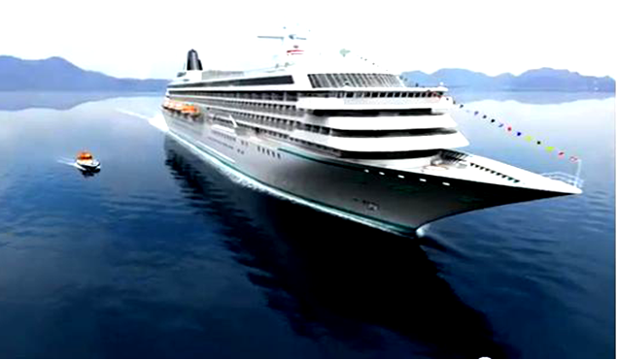
The next delivery…
Risk and Cost/Benefit analyses to be delivered to NAV 59
The prioritization of main solutions to achieve workable and efficient results is the basis for the analyses
Notes:
e-navigation has a wide scope. It is a concept that will, and should, evolve over time in support of improved safety, security and environmental protection, and where appropriate should enhance commercial efficiency. However, we need to start somewhere.
There are in this respect also a number of commercial products, and many more to come, that may enhance the exchange of data for the purpose of improved safety and efficiency both at sea and ashore.
Hence, the effectiveness and success of e-navigation will consequently also rely on the industry’s ability to ensure usability, data quality, system reliability, and the provision of information to support decision making. These areas will all be essential within an e-navigation Strategy Implementation Plan.
Focusing on improving the means of seamless information transfer concentrates our efforts to secure an important component of e-navigation, which is the infrastructure that could serve as one of the foundations for future growth.

Slide 18
Work towards 2014
Risk analysis
Cost/benefit analysis
Development of:
Maritime Service Portfolio
Guidelines for testing usability
Guidelines for test-beds
Guidelines for quality assurance of data
Strategy Implementation Plan
Notes:
In summary, in the work towards 2014 several actions are to be carried out before a final strategic implementation plan is presented.

Slide 19
The Strategy Implementation Plan
Identification of responsibilities
Transition arrangements,
A phased implementation schedule
Priorities for deliverables
Proposals for a systematic assessment of the development of new technology
A plan for the requirements of e-navigation in the longer term,
Proposals on public relations
Identification of potential sources of funding
Notes:
The Strategy Implementation Plan will be presented in 2014, in according with the IMO work program on e-navigation. The work program identifies eight topics, which is presented on this slide.
Identification of responsibilities to appropriate organizations/parties,
Transition arrangements,
A phased implementation schedule along with possible roadmaps,
Priorities for deliverables, resource management and a schedule for implementation and the continual assessment of user needs,
Proposals for a systematic assessment of how new technology can best meet defined and evolving user needs,
A plan for the development of any technology and institutional arrangements necessary to fulfill the requirements of e-navigation in the longer term,
Proposals on public relations and promotion of the e-navigation concept to key stakeholder groups,
Identification of potential sources of funding for development and implementation, particularly for developing regions and countries and of actions to secure that funding.
When the draft on the final proposal on the Strategy Implementation Plan begins after NAV 59 in September this year, a fundamental question should be raised. How can we ensure global implementation of the proposed e-navigation solutions?

Slide 20
2014: Mission completed!
Notes:
The introduction of the e-navigation strategy implementation plan in 2014 is not the end of the e-navigation process. It is not even the beginning of the end.
It is the start of a long-term process where authorities as Flag States, Port States and Coastal States, international organizations, manufacturers, ship owners, training institutions, mariners, ports and all relevant shorebased personnel accept and develop procedures, systems, equipment for harmonization, standardization and integration. At the same time, we have to realize that we are moving quickly in a digital age. It is essential to ensure that we make benefit of this development. The bottom line is that e-navigation is about human beings effectively sharing and using essential maritime information, making their professional lives easier, safer and more efficient.
This is what e-navigation should do for us.
When e-navigation solutions will be put into action, we must all pull together. We will rely on the positive attitudes, will and involvement of human beings for achieving e-navigation successfully on a global scale.
Thank you for your attention!

